Slide 1


Slide 2


Slide 3


Slide 4


Slide 5
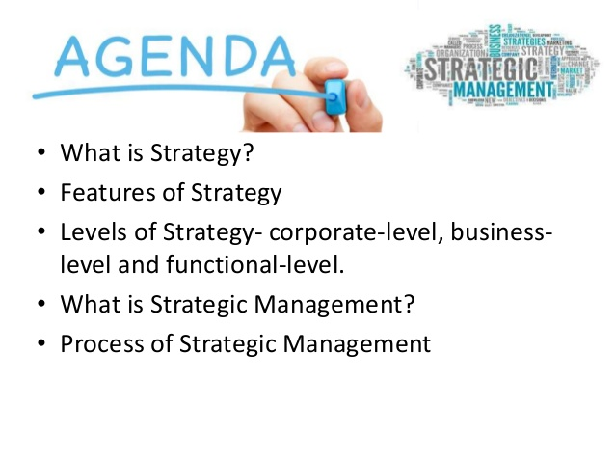

Slide 6
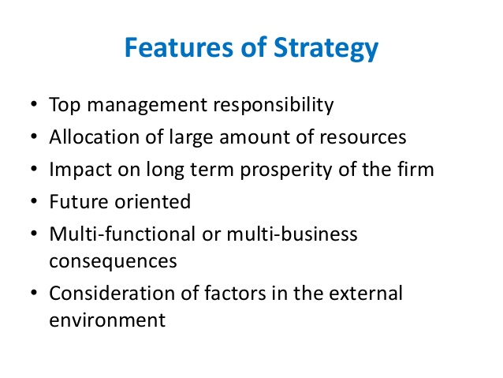

Slide 7
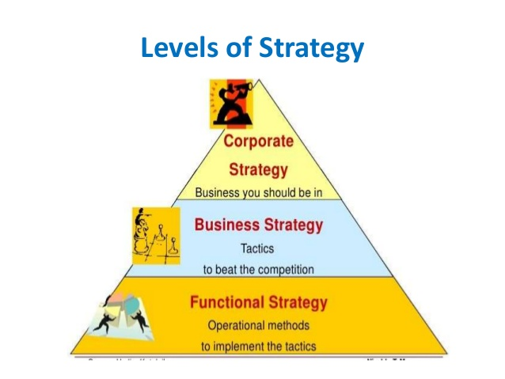

Slide 8
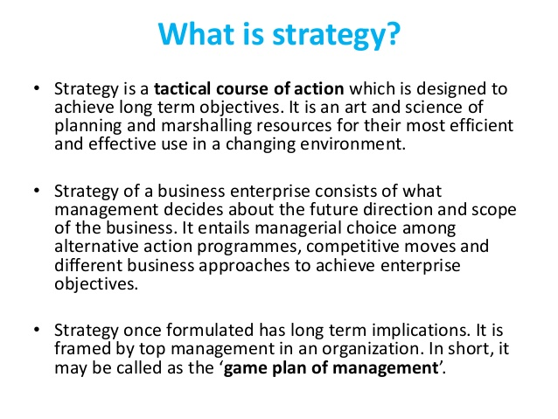

Slide 9
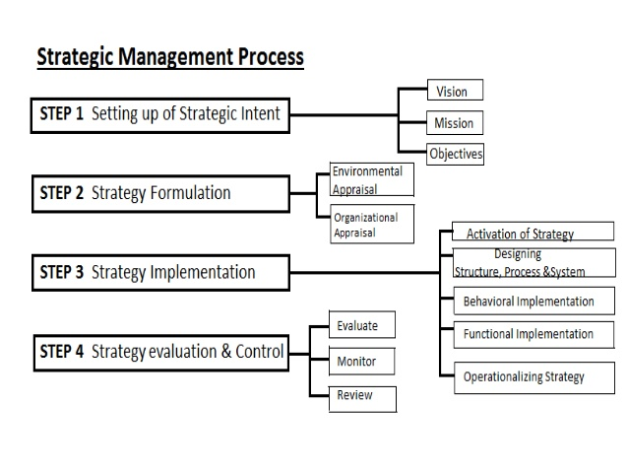

Slide 10
Key Terms in Strategic Management
Vision statement
  answers the question “What do we want to become?”
  often considered the first step in strategic planning
1-<number>
Notes:
The Vision statement answers the question “What do we want to become?” and is often considered the first step in strategic planning

Slide 11
Key Terms in Strategic Management
Mission statements
  enduring statements of purpose that distinguish one business from other similar firms
  identifies the scope of a firm’s operations in product and market terms
  addresses the basic question that faces all strategists: “What is our business?”
1-<number>
Notes:
Mission statements are enduring statements of purpose that distinguish one business from other similar firms.
It identifies the scope of a firm’s operations in product and market terms and addresses the basic question that faces all strategists: “What is our business?”

Slide 12
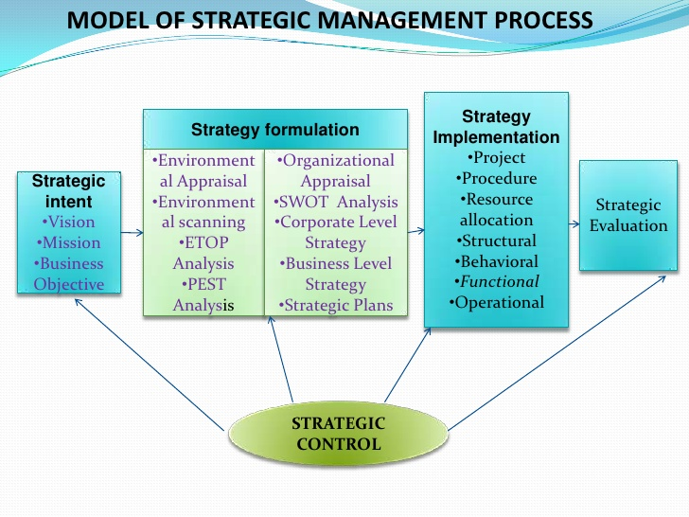

Slide 13
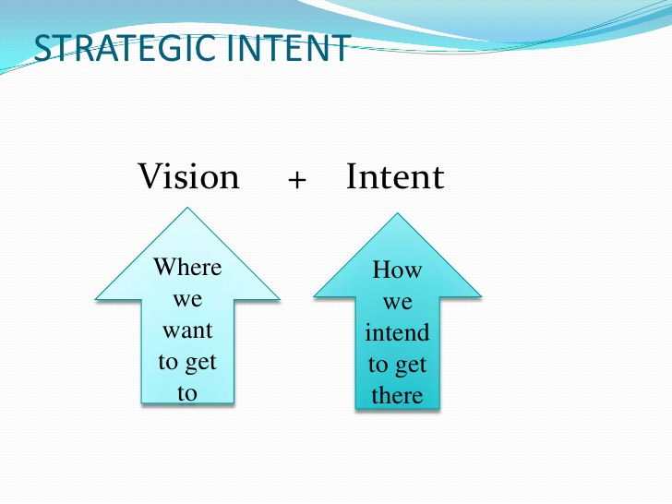

Slide 14
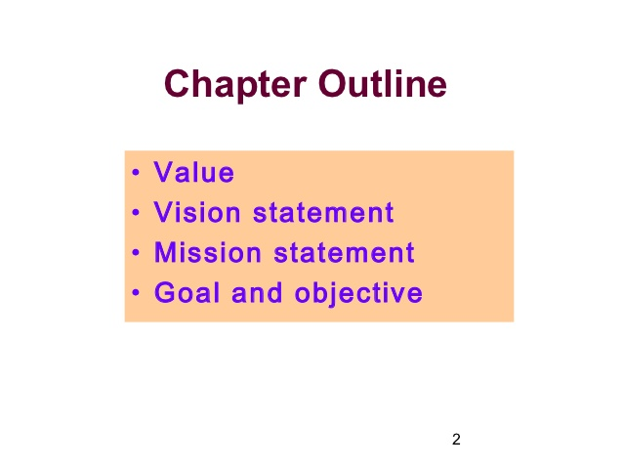

Slide 15
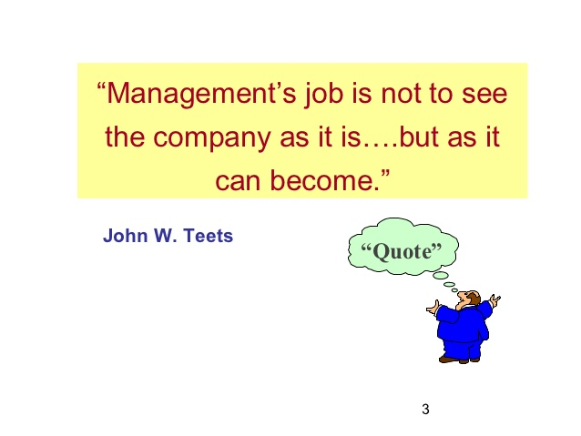

Slide 16
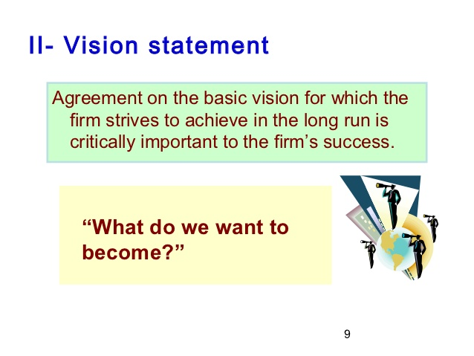

Slide 17
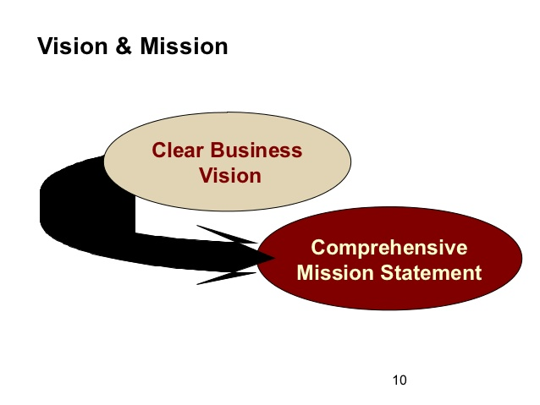

Slide 18
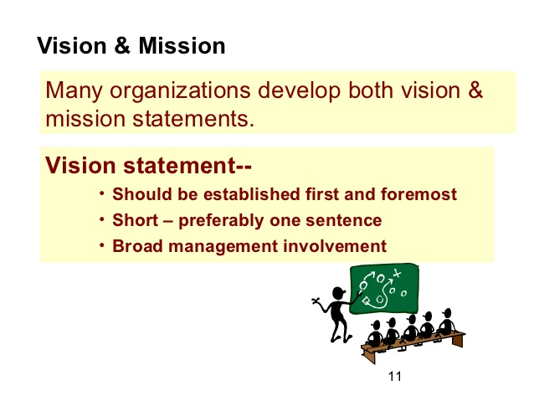

Slide 19
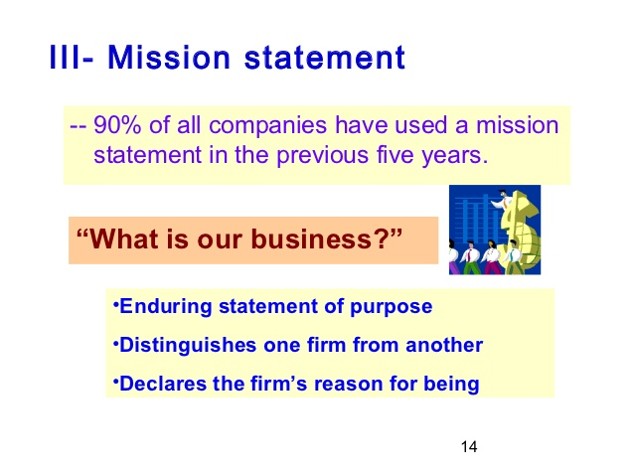

Slide 20
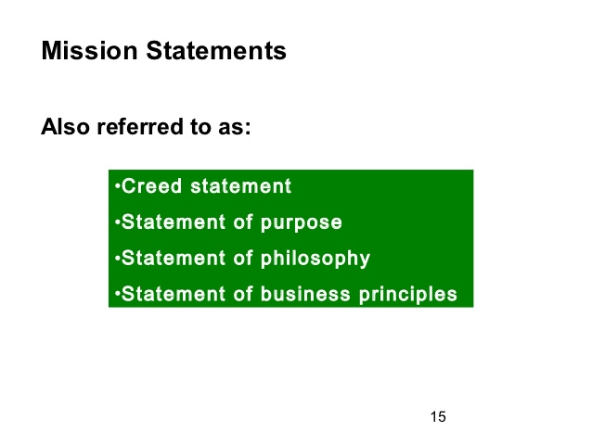

Slide 21
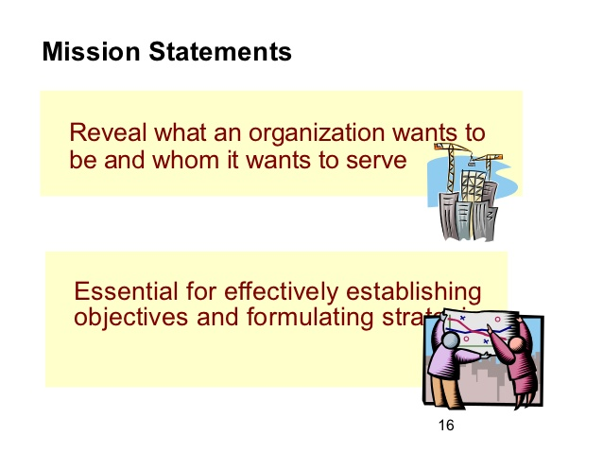

Slide 22
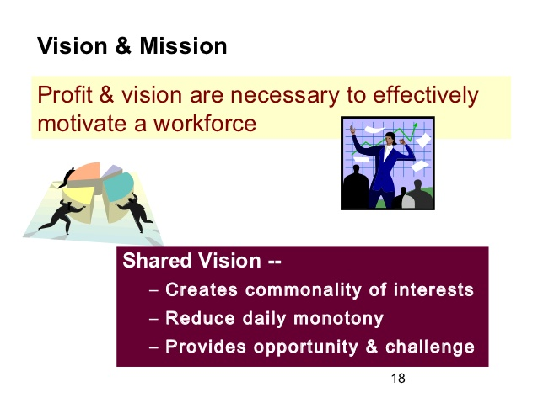

Slide 23
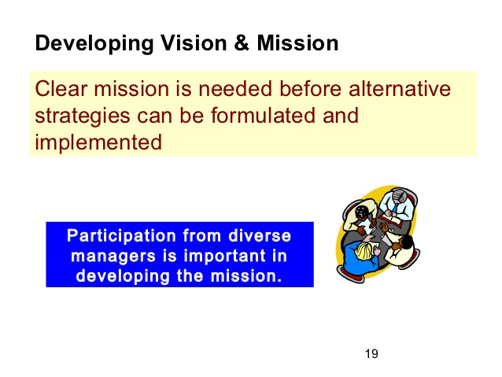

Slide 24
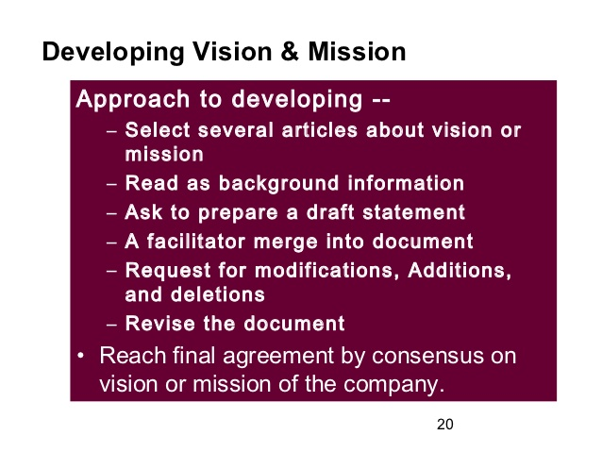

Slide 25


Google’s mission is to organize the world’s information and make it universally accessible and useful.
ITC’s mission : To enhance the wealth generating capability of the enterprise in a globalizing environment, delivering superior and sustainable stakeholder value

Slide 26
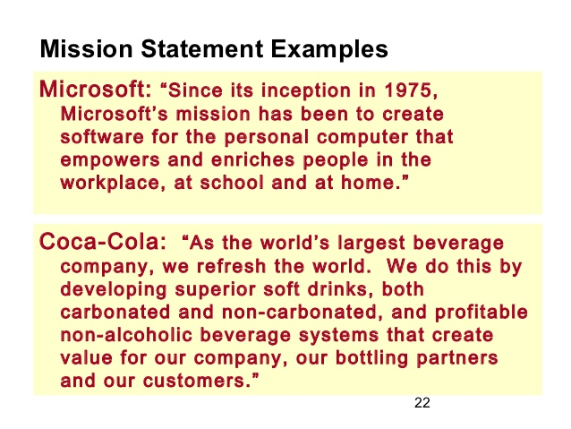

Slide 27
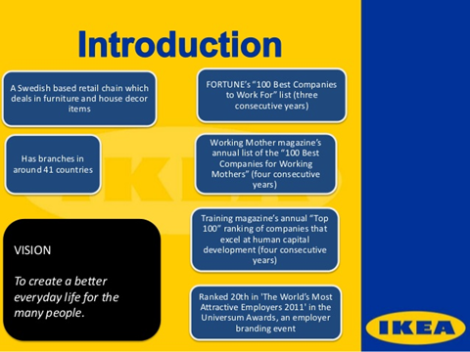


Slide 28
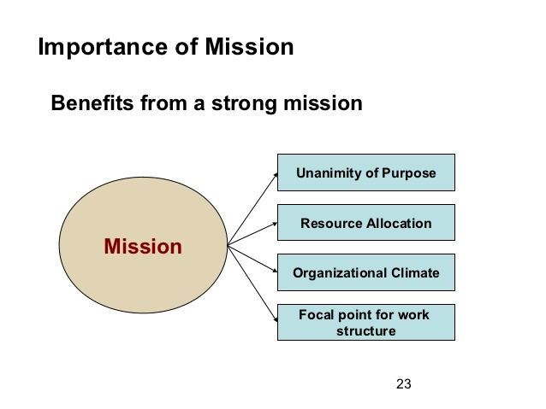

Slide 29
